Slide 1
網 路 最 佳 化 管 理
Minimum Cost Flows
CONTENTS:
Introduction to Minimum Cost Flows (Section 9.1)
Applications of Minimum Cost Flows (Section 9.2)
Structure of the Basis (Section 11.11)
Optimality Conditions (Section 9.3)
Obtaining Primal and Dual Solutions (Section 11.4)
Network Simplex Algorithm (Section 11.5)
Strongly Feasible Basis (Section 11.6)
READING ASSIGNMENTS:
Chap 9, 11

Slide 2
Minimum Cost Flow Problem
Determine a least cost shipment of a commodity through a network in order to satisfy demands at certain nodes from available supplies at other nodes. Arcs have capacities and cost associated with them.
-15
2
2
4
2
5
3
1
10
1
4
5
4
7
10
3
6
6
3
6
Distribution of products
Flow of items in a production line
Routing of cars through street networks
Routing of telephone calls
5
-5

Slide 3
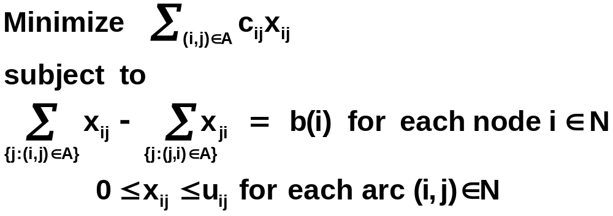
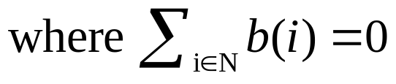
Minimum Cost Flow Formulation
Mathematical Formulation:
Supply nodes (b(i) > 0); Demand nodes (b(i) < 0),
Transhipment nodes (b(i) = 0)
Mass balance constraints (flow out - flow in = supply/demand)
Flow bound constraints (lower and upper bound constraints)

Slide 4
Assumptions
All data (cost, supply/demand, capacity) are integral.
The network is directed.
The sum of supplies equals the sum of demands, and the problem admits a feasible flow.
The network contains an uncapacitated directed path between every pair of nodes.
All arc costs are non-negative.

Slide 5
Distribution Problems
A car manufacturer has several manufacturing plants and produces several car models at each plant that is shipped to various retailers. The manufacturer must determine the production plan for each model and shipping pattern that minimizes the overall cost of production and transportation.
p₁/m₁
r₁/m₁
p
₁
p₁/m₂
r₁/m₂
r₁
p₂/m₁
r₁/m₃
p₂/m₂
r₂/m₁
p
₂
p₂/m₃
r₂/m₂
r₂
Plant
nodes
Plant/model
nodes
Retailer/model
nodes
Retailer
nodes

Slide 6
Airplane Hopping Problem
1
2
3
……….….
n-1
n
A hopping flight visits the cities 1, 2, 3, … , n, in a fixed sequence.
The plane can pickup passengers at any node and drop them off at any other node.
Let b_{ij} denote the number of passengers available at node i who want to go to node j and let f_{ij} denote the fare for such passengers.
Determine the pickup policy to maximize the total fare.

Slide 7
Airplane Hopping Problem (contd.)
b(i)
c_{ij}
u_{ij}
b(j)
i
or
j
b₁₄
b₂₄
b₃₄
1-4
2-4
3-4
-f₂₄
-f₃₄
b₁₃
1-3
cost
-f₁₄
-f₁₃
b₁₂
b₂₃
2-3
-f₁₂
1-2
-f₂₃
1
p
2
p
3
p
4
capacity

Slide 8
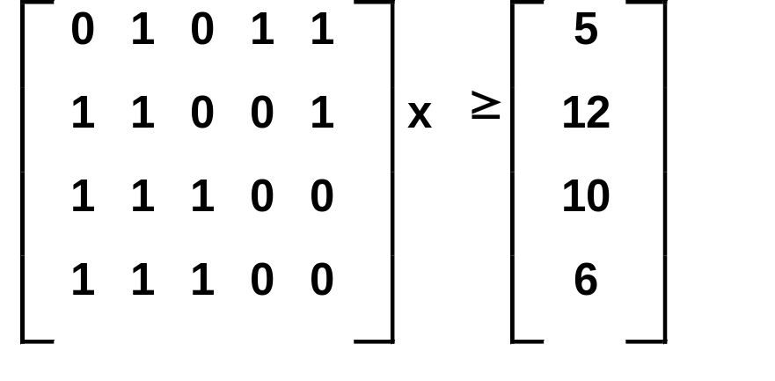
Linear Programs with Consecutive Ones
Consider the following linear programming problem:
Minimize cx
subject to
x ≥ 0
Subtract surplus variables y to convert inequalities to equations.

Slide 9
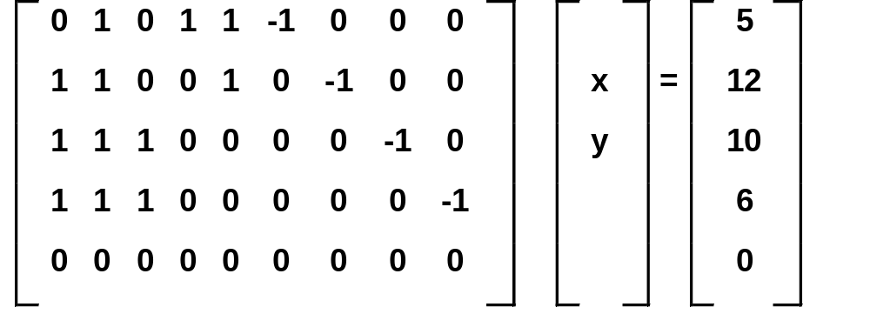
Linear Programs with Consecutive Ones (contd.)
Minimize cx
subject to
x, y ≥ 0
Subtract i^{th} constraint from the (i+1)^{th} constraint.

Slide 10
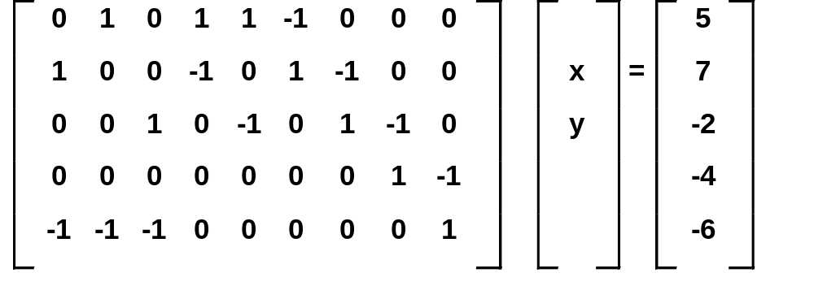
Linear Programs with Consecutive Ones (contd.)
Minimize cx
subject to
x, y ≥ 0
This is the formulation of a minimum cost flow problem.

Slide 11
Examples of LP’s with Consecutive Ones
Nurse scheduling
Telephone operator scheduling
Equipment replacement
Employment scheduling
Optimal capacity planning

Slide 12
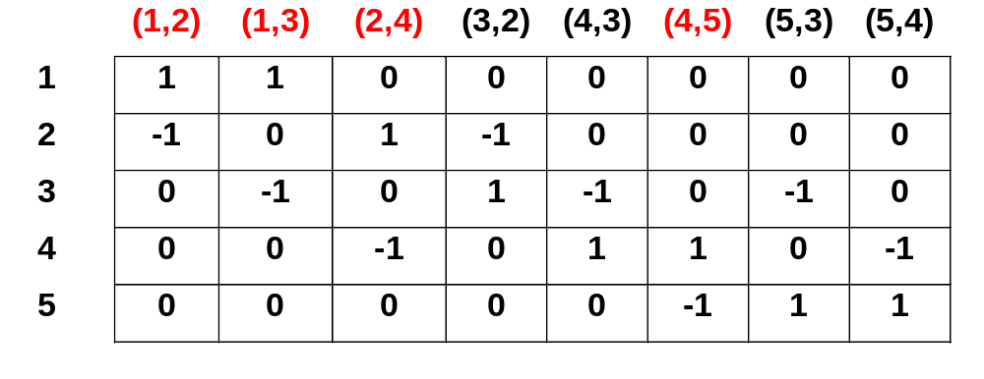
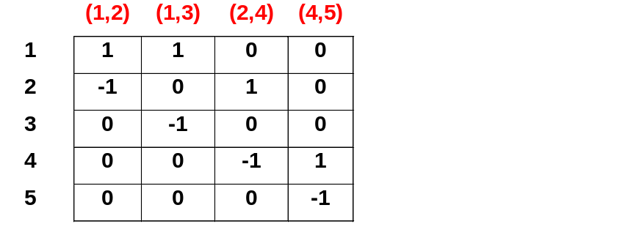
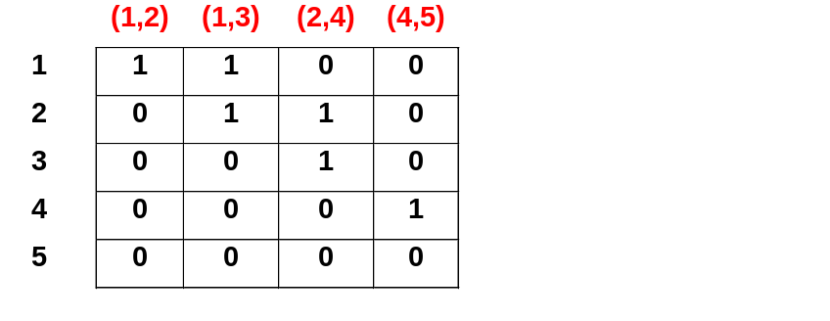
Properties of the Constraint Matrix
2
(15,40)
4
(25,30)
1
(45,10)
(15,30)
(45,60)
(35,50)
(35,50)
3
5
(25,20)
Spanning Tree ⬄
Triangular Basis
x_{ij} has a +1 in the i^{th} row and a -1 in the j^{th} row.
The rows of the constraint matrix are linearly dependent.
The rank of the constraint matrix is at most (n-1).

Slide 13
Properties of the Basis (contd.)
THEOREM: There is a one-to-one correspondence between basis of the minimum cost flow problem in G and spanning trees of G.
Triangularity property (or spanning tree property) allows us to speedup simplex computations substantially.
Computing Basic Feasible Solutions: Bx_{B} = b
Determining Simplex Multipliers: πB = c_{B}

Slide 14
Spanning Tree Structure
The minimum cost flow problem is a special case of the bounded variable linear programming problem.
Basic Arcs (T): Arcs in the spanning tree.
Nonbasic Arcs at Lower Bounds (L): Arcs not in the spanning tree with zero flow.
Nonbasic Arcs at Upper Bounds (U): Arcs not in the spanning tree at their upper bounds.
(T, L, U): Basis structure or Spanning tree structure.
Feasible spanning tree structure
Optimal spanning tree structure

Slide 15

Optimality Conditions
THEOREM: A spanning tree structure (T, L, U) is an optimal spanning tree structure of the minimum cost flow problem if it is feasible and there exists a vector of dual variables (called, node potentials) π such that the arc reduced costs satisfy the following conditions:
= 0 for all (i, j) ∈ T,
≥ 0 for all (i, j) ∈ L,
≤ 0 for all (i, j) ∈ U.
where = c_{ij} - π(i) + π(j).
PROOF: These are the LP optimality conditions specialized for the minimum cost flow problem.

Slide 16
Maintaining a Spanning Tree Structure
We consider the spanning tree hanging from a specially designated node, called the root.
We associate three indices with each node i of the tree:
  pred(i): The predecessor index. Maintains the parent of node i in the tree.
  depth(i): The depth index. Maintains the number of arcs from node i to the root node.
  thread(i): The thread index. Defines a depth-first traversal of the tree.

Slide 17
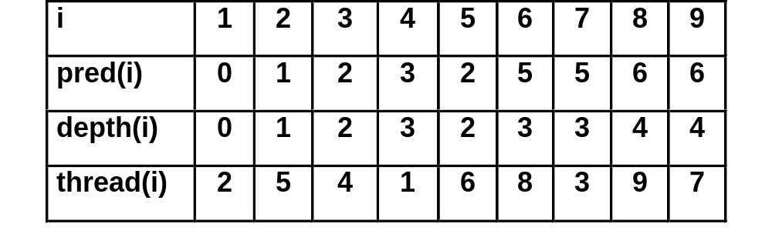
Maintaining a Spanning Tree Structure (contd.)
1
2
5
3
6
7
4
8
9

Slide 18
Computing Node Potentials
The node potentials π are computed using the fact that
= 0 for every basic arc (i, j) ∈ T
where = c_{ij} - π(i) + π(j).
i
π(i)
i
π(i)
j
π(j) = π(i) - c_{ij}
j
π(j) = π(i) + c_{ji}

Slide 19
Computing Node Potentials (contd.)
1
0
1
0
5
0
2
-5
2
2
3
0
3
0
-3
5
3
-2
5
4
1
1
0
-7
6
7
-2
6
7
0
4
4
-1
0
Initial potential π(i)=0
π(i)
π(j)
c_{ij}
0
c_{ij}
0
i
j
i
j

Slide 20
Computing Node Potentials (contd.)
Procedure computing node-potentials
begin
π(1) : = 0;
j : = thread(1);
while j ≠ 1 do
begin
i : = pred(j);
if (i, j) ∈ A then π(j) : = π(i) - c_{ij};
if (j, i) ∈ A then π(j) : = π(i) + c_{ji};
j : = thread(j);
end
end

Slide 21
Computing Arc Flows
Suppose that there is a leaf node j with supply/demand b(j).
i
b(i)
i
b(i)
x_{ij} = -b(j)
x_{ij} = b(j)
j
b(j)
j
b(j)
demand leaf
supply leaf

Slide 22
Computing Arc Flows (contd.)
15
b(i)
1
1
5
i
i
10
-20
0
2
3
2
3
x_{ij}
5
5
10
15
j
j
4
5
6
7
4
5
6
7
b(j)
5
5
10
-15

Slide 23
Procedure computing arc-flows (when U = Ø)
begin
b′(i) : = b(i) for all i ∈ N;
for each (i, j) ∈ L do set x_{ij} : =0;
T′ : = T;
while T′ ≠ {1} do
begin
select a leaf node j in T′;
i : = pred(j);
if (i, j) ∈ T′ then x_{ij} : = -b′(j);
else x_{ji} : = b′(j);
b′(i) := b′(i) + b′(j);
delete node j and the arc incident to it from T′;
end
end
(when U ≠ Ø)
for each arc (i, j) ∈ U do
x_{ij} := u_{ij},
b′(i) := b′(i) - u_{ij} ;
b′(j) := b′(j) + u_{ij} ;
end

Slide 24
Network Simplex Algorithm
Algorithm network-simplex;
begin
determine the initial feasible tree structure (T, L, U);
let x be the flow and π be the node potentials;
while some nontree arc violates its optimality condition do
begin
select an entering arc (k, l) violating its opt. condition;
add arc (k, l) to the tree and determine the leaving arc;
perform a tree update, and update x and π;
end
end

Slide 25
Obtaining initial Basis Structure
2
b(2) < 0
6
b(6) < 0
3
b(3) < 0
1
7
b(7) ≥ 0
4
b(4) ≥ 0
5
b(5) ≥ 0
Create G’ by
  Adding a dummy supply/demand supper node
  Adding artificial arcs from the supper node to demand nodes
  Adding artificial arcs from supply nodes to the supper node
All arcs in G have zero flow;

Slide 26

Entering Arc Selection
Optimality Conditions:
≥ 0 for every arc (i, j) ∈ L;
≤ 0 for every arc (i, j) ∈ U;
Eligible Arcs:
< 0 for any arc (i, j) ∈ L;
> 0 for any arc (i, j) ∈ U;
Violation of an eligible arc:

Slide 27
Pivot Rules
Dantzig’s Pivot Rule: Select the arc with the maximum violation as the entering arc.
First Eligible Arc Pivot Rule: Select the first eligible arc found as the entering arc.
Candidate List Pivot Rule:
  Major iteration: Construct the candidate list.
  Minor iteration: Select an entering arc from the candidate list.

Slide 28
Pivot Operation
1
Determine the pivot cycle W defined by the entering arc.
Determine the maximum flow δ that can be augmented along W.
Example:
δ = min{u₄₃-x₄₃, u₃₂-x₃₂, u₂₅-x₂₅, x₅₆, u₆₉-x₆₉, u₉₄-x₉₄}
Degenerate iteration (δ =0)
Nondegenerate iteration (δ >0)
Update the flow.
Determine the leaving arc.
Apex
2
5
3
6
7
4
8
9
Entering arc

Slide 29
Pivot Operation
1
Get the new spanning tree.
Update the node potentials.
Update the tree indices.
2
5
3
6
7
4
8
9
Entering arc

Slide 30
Example of Network Simplex Algorithm
b(i)
b(j)
π(i)
π(j)
(c_{ij},u_{ij})
i
x_{ij}
j
i
j
-3
-8
2
(5,7)
4
2
5
4
(3,8)
(3,5)
6
1
(2,2)
(5,4)
6
-9
0
1
1
6
-9
9
(2,3)
(2,3)
3
4
(4,6)
3
5
3
3
5
(4,3)
-2
-5

Slide 31
Example of Network Simplex Algorithm (contd.)
-3
-8
-3
-8
2
5
4
2
4
4
5
6
4
7
0
1
6
-10
0
1
6
-11
2
4
3
5
3
2
5
3
5
-2
-6
-2
-7

Slide 32
Running Time Analysis
Time per Iteration:
  Update the flow (takes O(n) time).
  Update the node potentials (takes O(n) time).
  Update the tree indices (takes O(n) time).
Number of Iterations:
  Number of non-degenerate pivots: O(mCU)
  Number of degenerate pivots: No bound is possible

